Slide 1
Routes of Exposure for Biohazards
Involved in Laboratory Acquired Infections

Slide 2
Lab Acquired Infections 1930 -2015
1930 – 2015
7,325 LAIs (Symptomatic and Asymptomatic)
210 Fatal LAI’S
Byers KB and Harding, AL. Laboratory-Associated Infections. 2017. In: Wooley, DP, and Byers, KB, editors, Biological Safety: Principles and Practices, 5th Ed., Washington, DC: ASM Press. p. 59 – 94.
Pike RM. 1979. Laboratory-associated infections: incidence, fatalities, causes, and prevention. Annu Rev Microbiol: 33: 41 -66.
Sulkin SE, Pike RM. Survey of laboratory-acquired infections. Am J Pub Hlth. 1951; 41: 769-81.

Slide 3
What is known about Exposure routes?
Percutaneous
Facial Mucous Membranes
Ingestion
Inhalation
*Contact
*Contact involves self-inoculation through one of the known exposure routes

Slide 4
Golden Age of Biosafety (1949 – 1979)
There can be unnatural routes of exposure in the laboratory setting that are generally not seen in nature.
(Sulkin 1960)

Slide 5
Infections with unidentified route of exposure
Non-traditional exposure route

Slide 6
Non-Traditional Exposure routes
GI Pathogens: Salmonella, Listeria, Shigella, Campylobacter, E. coli, etc.
Eye
Nasal Cavity
Throat
Gut
Thomas, R.J., “Particle Size and Pathogenicity in the Respiratory Tract.” Virulence 4:8, 847-858; November 15, 2013.

Slide 7
Non-Traditional Exposure routes
GI Pathogens: Salmonella, Listeria, Shigella, Campylobacter, E. coli, etc.
Aerosol
Nasal muco-ciliary escalator
Throat
Gut
Aerosol
Tracheo-bronchial
mucociliary escalator
Throat
Gut

Slide 8
ROUTE OF EXPOSURE TREES
INGESTION
VIA EATING, DRINKING OR CONTACT
VIA NASAL
LACRIMAL DUCT
VIA MUCOCILLIARY ESCALATOR

Slide 9
Ingestion likely unrecognized
Not cognizant of Hand to face contact
Poor work practices in shallow water (Jim welch)
Lack of recognition of possible role of aerosols from contamination to host entry
Can’t “feel” the exposure
Competing risks outside of lab
Cdc: 48 million foodborne illnesses annually
Many self medicate and don’t report
Over 250 foodborne pathogens

Slide 10
Non-Traditional Exposure routes
West Nile Virus, Yellow Fever Virus, Rabies Virus, Influenza Virus, Neisseria meningitidis, Streptococcus pneumoniae
Aerosol
Nasal Cavity
Cranial Nerves
Brain

Slide 11
Nasal Cavity to Brain via cranial nerves
Influenza A virus, herpes viruses, poliovirus, paramyxoviruses, vesicular stomatitis virus, rabies virus, parainfluenza virus, adenoviruses, Japanese encephalitis virus, west nile virus, Chikungunya virus, lacrosse virus, Bunyaviruses, Streptococcus pneumoniae, Neisseria meningitidis, Burkholderia pseudomallei, Listeria monocytogenes, lymphocytic Choriomeningitis virus, Naegleria fowleri, EEE, VEE, WEE
Dando, s.J. et al, “Pathogens Penetrating the central nervous system: infection pathways and cellular and molecular mechanisms of invasion.” 2014. Clinical Microbiological reviews, Vol. 27 No. 4, 691-726, October 2014
Beloor, J. et al, “Small interfering rna-mediated control of virus replication in cns is therapeutic and enables natural immunity to west nile virus,” 2018. Cell Host & Microbe, 23, 549-556, April 11, 2018.
Van riel, et al, “The olfactory nerve: a shortcut for influenza and other viral diseases into the central nervous system, Journal of Pathology; 235, 277-287, 2015.

Slide 12
Non-Traditional Exposure routes
West Nile Virus, Yellow Fever Virus, Rabies Virus, Neisseria meningitidis, Sabia Virus, EEE, WEE, VEE
Aerosol
Lower Lung
Blood stream
Thomas, R.J., “Particle Size and Pathogenicity in the Respiratory Tract.” Virulence 4:8, 847-858; November 15, 2013.
Winkler, W.G. 1973. Airborne rabies transmission in a laboratory worker. JAMA 226 (10):1219-1221.
Centers for Disease Control. 1977. Rabies in a laboratory worker, New York. MMWR 26(22): 183-184

Slide 13
ROUTE OF EXPOSURE TREES
INHALATION
FACIAL MUCOUS MEMBRANES
CRANIAL NERVES FROM NOSE TO BRAIN
Mucociliary Escalators - Gut
INHALATION
Lung (Epithelial cells, other)
Blood (alveoli, lymphatic system)
Contact (from contaminated surfaces)

Slide 14
Recognized vs. unrecognized exposures: People report what they can “feel”
Feel splashes/splatter to face or skin
Feel needle sticks, lacerations, punctures, cuts, etc.

Slide 15
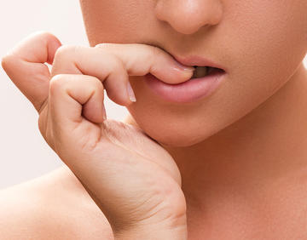
What you can’t feel is (probably) not reported?
Ingestion
Inhalation
May also not feel exposure through micro-abrasions

Slide 16
Golden Age of Biosafety (1949 – 1979)
The laboratory can be more dangerous than nature due to the ability to amplify and concentrate pathogens to levels not seen in nature. Also, the growth and propagation of infectious agents in laboratory settings are conducted repeatedly within the laboratory as part of the research effort, enhancing the potential exposure.
(Langmuir 1960)

Slide 17
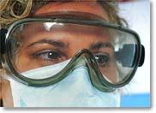
ROUTE OF EXPOSURE TREES
Facial Mucous Membranes
Blood, Lymph
CRANIAL NERVES - FROM NOSE TO BRAIN
GUT (from eye, nose or mouth)

Slide 18
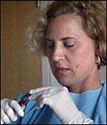
Hand to face contact (HFC) Article
72% of researchers touched face at least once
Average of 2.6 HFCs/hr
HFC found “common” among BSL-2 lab workers
Possibly an overlooked route of exposure for unknown LAIs
High likelihood of finger, hand and wrist contamination
Only 3 of 93 researchers wore eye or face protection in the BSL-2 lab
Johnston, J.D., et al, “The Influence of Risk Perception on Biosafety Level-2 Laboratory Workers’ Hand-To-Face Contact Behaviors,” Journal of Occupational and Environmental Hygiene, Vol. 11, pp 625-632, September 2014

Slide 19
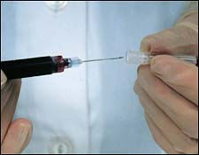
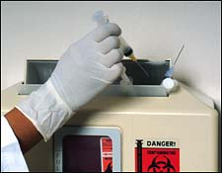
ROUTE OF EXPOSURE TREES
Percutaneous
SKIN
(Local infections)
BLOOD STREAM
FACIAL MUCOUS MEMBRANES

Slide 20
Percutaneous exposures
Needle sticks, lacerations, punctures, bites
Unhealed wounds
Breaks in skin, cuticles, posion ivy, eczema, dermatitis
Acne, other micro-abrasions

Slide 21
Glove - leak rate - facts
Glove Leak Rates | Exam Gloves | Surgical Gloves
Before Use (FDA) | 2.5% | 1.5%
After Use | *21 – 35% | **15.2%
**Double gloving: leak rates for inner gloves when double gloved - 1.17% (98.83% Effective!)
*Boyle, B & Boyle, T, “Loss of Glove Integrity During Laboratory Animal Care Providers Daily Tasks,” Lenape Regional High School, Medford NJ, Science Fair Poster Presentation, 2017
**Makama, J.G. et al, “Glove Perforation Rate in Surgery: A Randomized, Controlled Study to Evaluate the Efficacy of Double Gloving,” Surgical Infections, Vol. 17 No. 4, pp 436-442, March 16, 2016

